Slide 1
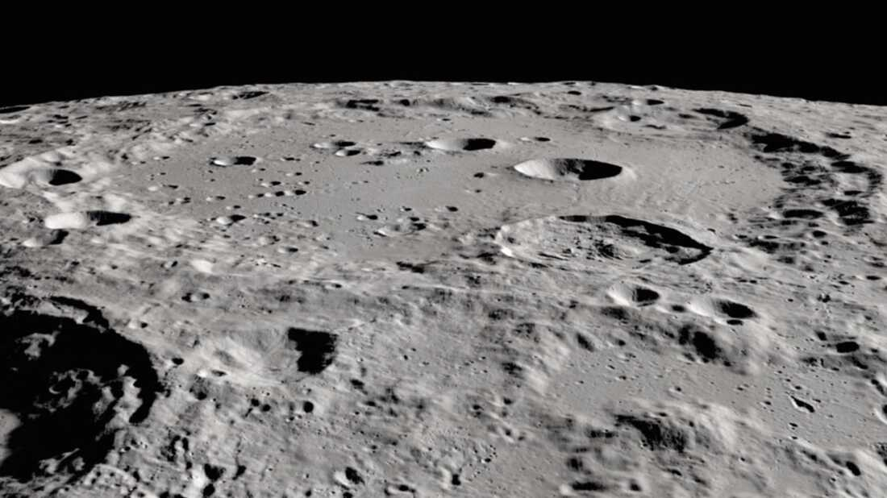
ARTEMIS II & YOU
The Lunar Expedition

Slide 2
The Artemis Program
The Artemis program’s end goal is to carry out travel and exploration in Mars, and after the success of the Artemis I, the second phase began.
The Artemis II is the second mission of the Artemis program and will be the first mission to send a woman and a man of colour to the moon.
The Artemis II will go on a 15 – day trip without landing on the moon.

Slide 3
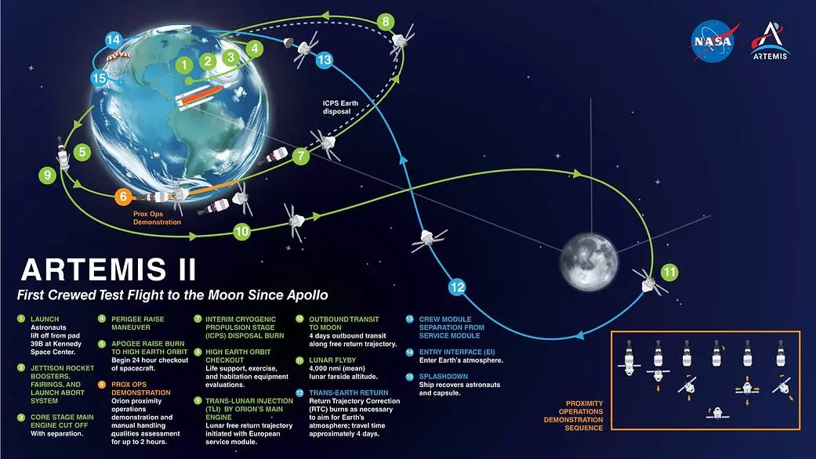
The Flight Plan

Slide 4
Did you Know?
Recent discoveries suggest that water ice exists on the Moon, particularly in permanently shadowed regions near the lunar poles. This discovery has significant implications for future lunar exploration and potential resource utilization.
While not readily visible, the Moon is also believed to contain deposits of helium-3, a potential future fuel source for nuclear fusion.

Slide 5
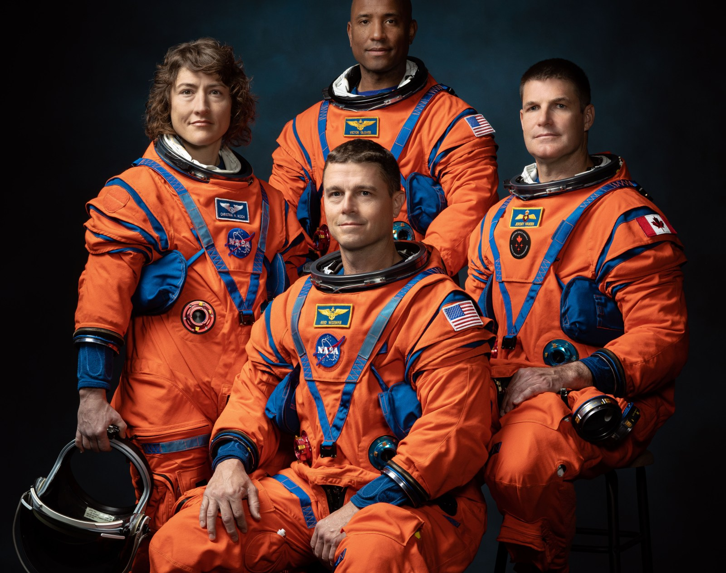
Meet The Artemis II Crew
Victor Glover (TOP)
Pilot
Reid Wiseman (BOTTOM)
Commander
Christina Koch (LEFT)
Mission Specialist
Jeremy Hansen (RIGHT)
Mission Specialist

Slide 6
The Artemis II crew is a diverse crew made up of a Canadian, a woman, a person of colour and an American. This is as important scientifically as it is culturally being a huge step towards the humans to Mars initiative and also diversity and inclusion in future projects. The Artemis II crew will inspire a new generation of explorers, uncover new scientific discovery, economic benefit. I believe exploration of the moon will give us more insight into our universe, other planetary bodies and a chance for global collaboration.

Slide 7
Inspiring Others
As a young boy from Western Africa, I always wondered what mystries the night skies held, and often times I would stargaze connecting constellations while waiting for a shooting star, I never knew someday I would get the opportunity to present before the bright minds from the NASA. Being part of the Artemis generation is a priviledge because not only do we get to witness a historic feat in the advancement of space exploration but also get a feel of belonging with the Artemis diversity and inclusion initiative.
Now when the little boy from my community sees a man of colour just like him in the Orion space suit, he knows its okay to dream and the moon is never out of his reach. The young lady from my community will not shield her ambitions of going to space because she sees a female astronaut on her way to making history, because in her words, "if she can do it, so can I",. And like a beacon of hope, The Artemis II mission will motivate people towards STEM careers, bringing out the fun and interesting parts of science.

Slide 8
Future Of Space Exploration
The Artemis program is not just about landing humans on the Moon; it is also about inspiring people around the world to dream big and pursue their passions. The program aims to create new opportunities for people from diverse backgrounds to participate in space exploration . When young boys and girls from my community see people who look like them in space suits, I know that it is okay to dream big and that nothing is impossible. They can aspire to become astronauts, scientists, or engineers themselves and contribute to humanity’s progress in space exploration .
The Artemis program has already had a significant impact on communities around the world. It has inspired people to pursue careers in science, technology, engineering, and mathematics (STEM) fields . It has also created new opportunities for international collaboration and partnerships between countries . The program has sparked public interest in space exploration and generated excitement about what humans can achieve when they work together towards a common goal .

Slide 9
Conclusion
We picked this challenge to use our work as a medium to educate and inspire more people to join space programs, I want to change the view of younger people, make it more entertaining, less farfetched and more relatable. We hope to bridge cultural, gender and racial gaps in with our project by helping the Artemis project reach a wider audience.

